Slide 1

FitBuddy
PERSONAL
TRAINING
PERSONAL
TRAINING
PERSONAL
TRAINING
PERSONAL
Personal Pocket Trainer
Fitness Presentation | 1

Slide 2

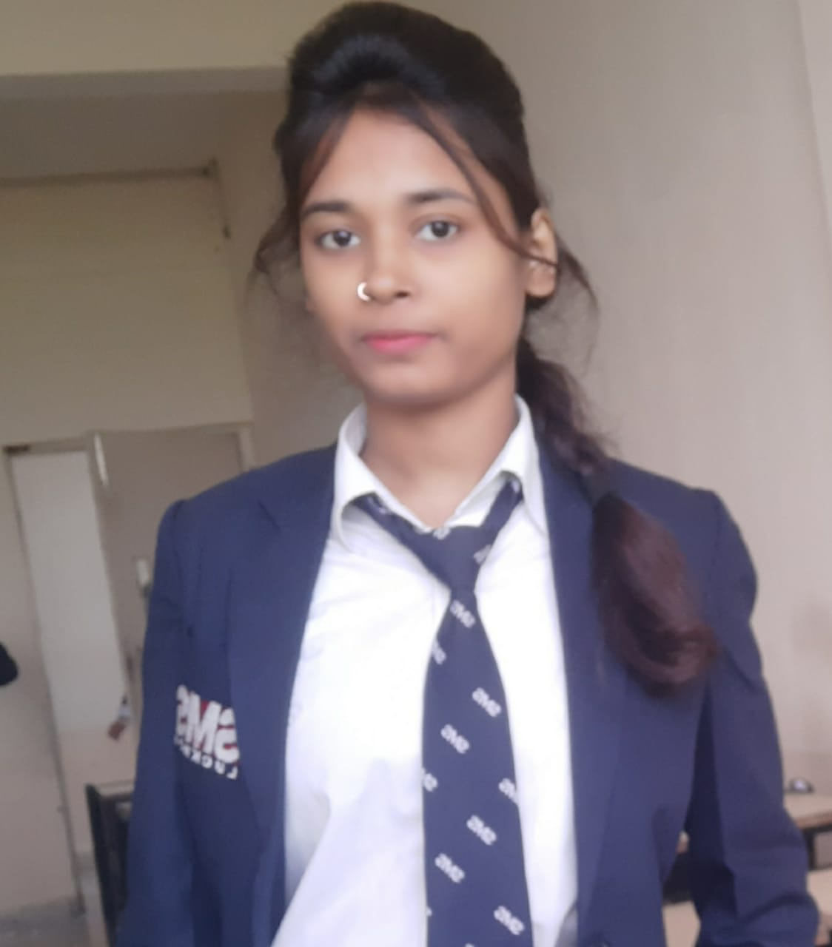
MEET OUR TEAM
Nazeem Ahmad
Komal Kumari

Slide 3

CONTENT
INTRODUCTION
Technical Introduction
Data flow diagram
ER Diagram
Future Scope
Conclusion
CONTENT
CONTENT

Slide 4

INTRODUCTION
INTRODUCTION
INTRODUCTION
INTRODUCTION
Fit Buddy is an android app which can help users in achieving their fitness goals.
It contains various modules to guide users and motivates them for a healthy & fit lifestyle.
It’s a task based fitness app which collects some data related to the user and gives them tasks to perform according to their fitness goals.
It provides Custom Diet Chart , Custom workout plan, notification reminder for better growth.

Slide 5
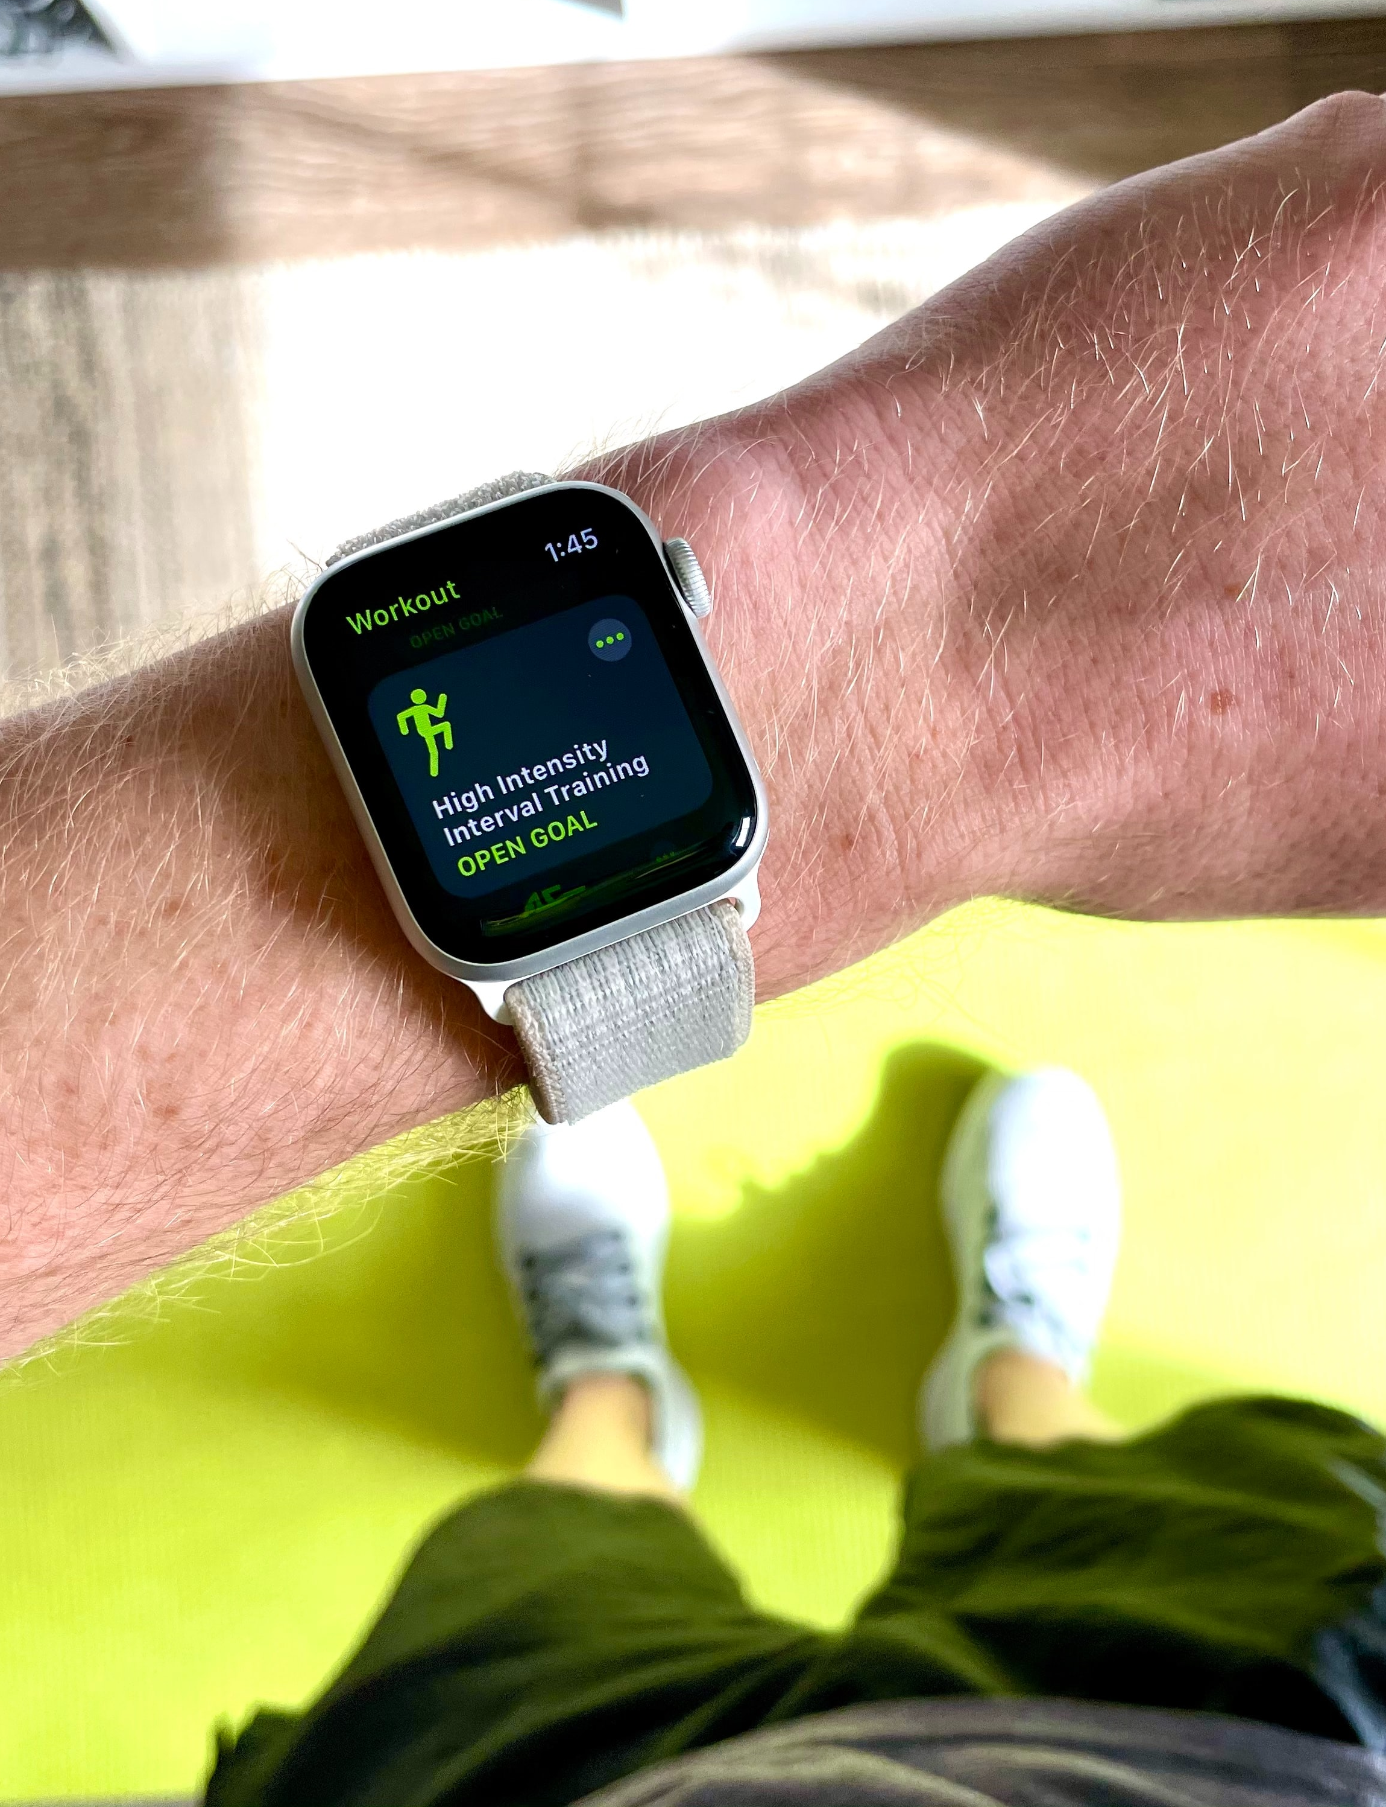
INTRODUCTION
Technical Introduction
Technical
Fit Buddy app is built on Android Studio using Java, Xml, Firebase & SQL.
The Frontend part like UI, Icons, Layouts, etc are built using Xml.
For the logics of app and backend part is written using Java.
For Storing the user data and track of fitness, custom email service Firebase is used.
For integration of database SQL is used.

Slide 6
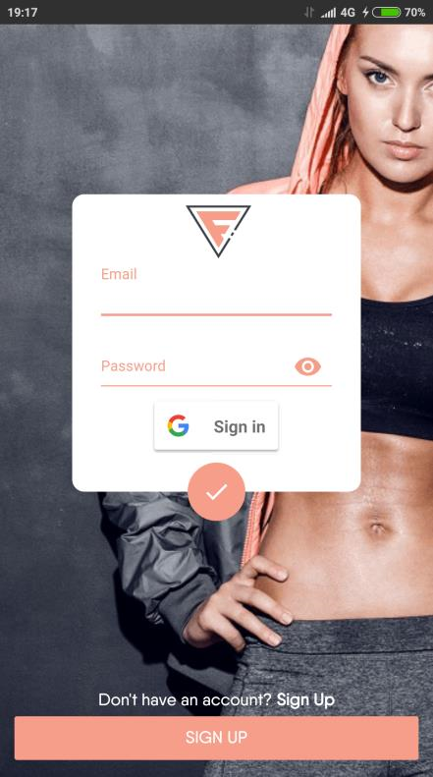
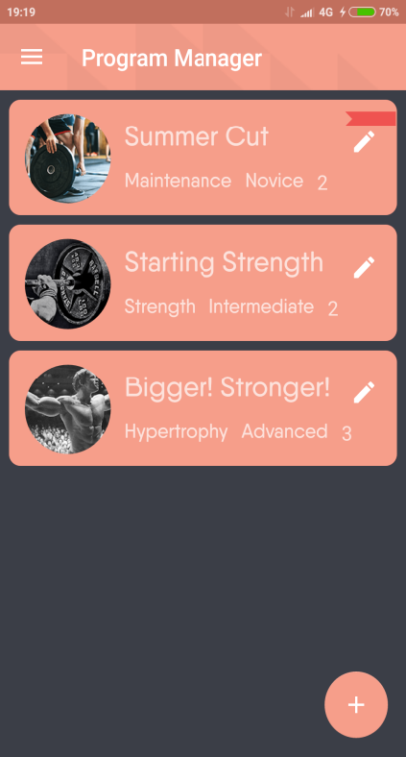
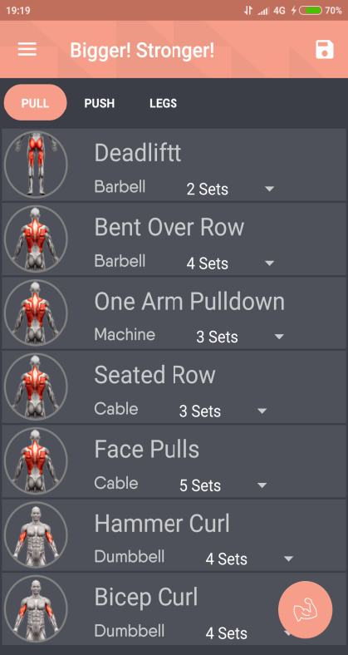
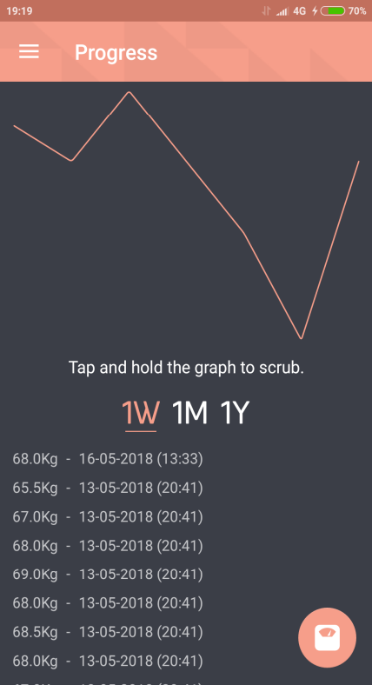
Layout Design

Slide 7
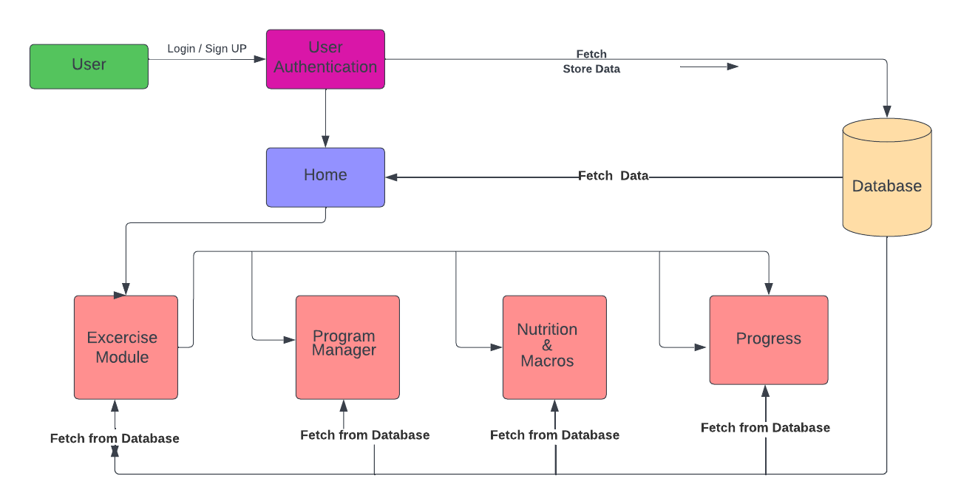
DFD of fitbuddy
DFD of FItbuddy

Slide 8
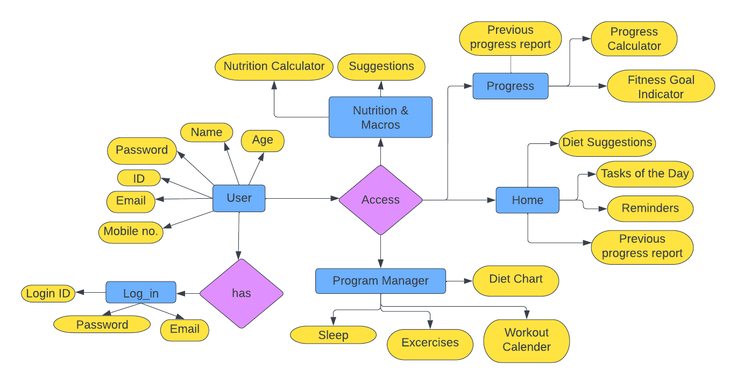
ER Diagram
ER Diagram

Slide 9
System
Requirements
Software Requirements
Android Version > V4.4
Android emulator (BlueStack)
Hardware Requirements
Chipset supporting android/ linux architecture.
Ram >2GB
Max. 500 mb free storage

Slide 10
Future Scope
Future Scope
Include feature like “Local GYM Locator”.
Add shopping Section for Supplements.
Create a community to let users support each other.
Informative fitness related content that educates users in fitness community.
Introduce a blog section where users can write and share their experience.
Monetize app for users to earn as a side hustle income.

Slide 11

Conclusion
FITNESS
FITNESS
FITNESS
FITNESS
FITNESS
FITNESS
FITNESS
CONCLUSION
It’s a personal training application.
It’s a free platform for people who cannot afford personal trainer in their budget.
People who are travelling continuously and do not have time to go to gym, this application will provide training in their pockets.
It helps user’s to track how close or far they are from their fitness goals.

Slide 12
THANK YOU
Thank you

